Slide 1
Learning the Java Language (http://docs.oracle.com/javase/tutorial/java/index.html)

Slide 2
Objectives
Study some fundamentals of Java languages: Data types, variables, arrays, operators, logic constructs.
Pass arguments to the main method
Input/output variables
Concept: Package.

Slide 3
Keywords and Identifiers
Keywords: Almost of them are similar to those in C language
Naming Convention:
Letter
$
_
Letters
Digits, $
_
Java is a case-sensitive language
Identifiers must be different to keywords

Slide 4
Primitive Data Types - Variables
Type | Bytes | Minimum | Maximum
char | 2 | \u0000 | \uFFFF
byte | 1 | -2⁷ | 2⁷ - 1
short | 2 | -2¹⁵ | 2¹⁵ – 1
int | 4 | -2³¹ | 2³¹ – 1
long | 8 | -2⁶³ | 2⁶³ - 1
float | 4
double | 8
boolean | true/false
A primitive is a simple non-object data type that represents a single value. Java’s primitive data types are:
Type var [=Initial value] ;

Slide 5
Operators
Category (Descending Precedence) | Operators
Unary | ++ -- + - ! ~ (type)
Arithmetic | * / % + -
Shift | << >> >>>
Comparison | < <= > >= instanceof == !=
Bitwise | & ^ |
Short-circuit | && ||
Conditional | ?:
Assignment | = op=
They are the same with those in C language

Slide 6
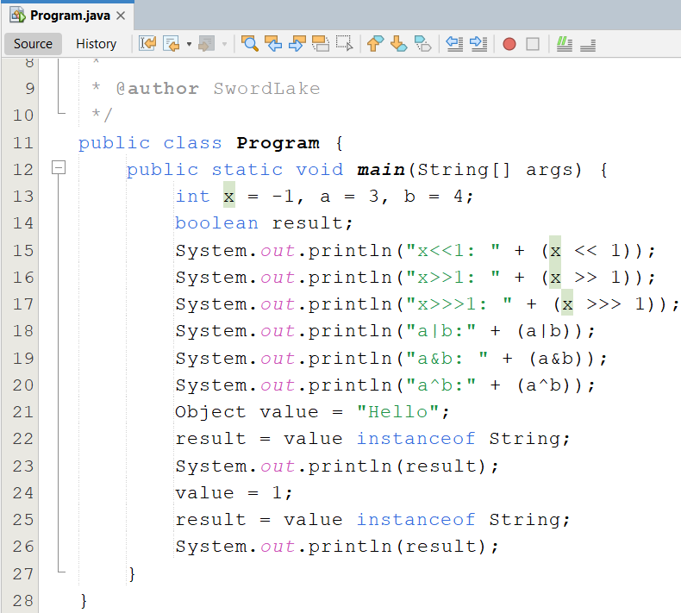
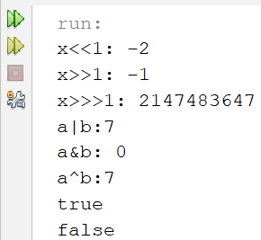
Using Operators Demonstration
Notes:
-1: 11111111 11111111 11111111 11111111
-1<<1 (singed):

Slide 7
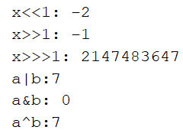
Using Operators Demonstration
Use 2 bytes to store value
1: ➔ 0000 0000 0000 0001
1111 1111 1111 1110 ( 1-complement)
-1 ➔ 1111 1111 1111 1111 ( 2-complement)
-1 <<1 ➔ 1111 1111 1111 1110 (-2)
-1 ➔ 1111 1111 1111 1111
-1 >>1 ➔ 1111 1111 1111 1111
-1 ➔ 1111 1111 1111 1111
-1 >>>1 ➔ 0111 1111 1111 1111 (2147483647)
3 ➔ 0000 0000 0000 0011
4 ➔ 0000 0000 0000 0100
3|4 ➔ 0000 0000 0000 0111 (7)
3 ➔ 0000 0000 0000 0011
4 ➔ 0000 0000 0000 0100
3&4 ➔ 0000 0000 0000 0000 (0)
3 ➔ 0000 0000 0000 0011
4 ➔ 0000 0000 0000 0100
3^4 ➔ 0000 0000 0000 0111 (7 ): XOR BIT

Slide 8
Literals and Value Variables
Character: ‘a’
String: String S=“Hello”;
Escape sequences: see the page 10
Integral literals:
28, 0x1c, 0X1A ( default: int). 123l, 123L (long)
Floating point:
1.234 (default: double)
1.3f 1.3F
1.3E+21
1.3d 1.3D
Value variable
Stack
n
10
int n=10;

Slide 9
Java Expressions
Java is an expression-oriented language. A simple expression in Java is either:
A constant: 7, false
A char - literal enclosed in single quotes: 'A', '3‘
A String - literal enclosed in double quotes: "foo“
The name of any properly declared variables: x
Any two|one of the preceding types of expression that are combined with one of the Java binary operators: i++, x + 2, (x + 2)

Slide 10

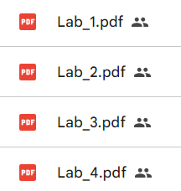
Practice

Slide 11
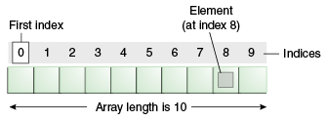
One Dimensional Arrays (1)
An array is a container object that holds a fixed number of values of a single type.
The length of an array is established when the array is created.
Each item in an array is called an element, and each element is accessed by its numerical index.

Slide 12
One Dimensional Arrays (2)
Declaring a Variable to Refer to an Array
int[] anArray;
or float anArrayOfFloats[];
Creating, Initializing, and Accessing an Array
anArray = new int[10];
Copying Arrays
Use arraycopy method from System class.
Notes:
class ArrayCopyDemo {
public static void main(String[] args) {
char[] copyFrom = { 'd', 'e', 'c', 'a', 'f', 'f', 'e', 'i', 'n', 'a', 't', 'e', 'd' };
char[] copyTo = new char[7];
System.arraycopy(copyFrom, 2, copyTo, 0, 7);
System.out.println(new String(copyTo));
}
}

Slide 13
One Dimensional Arrays (3)
int[] ar;
ar= new int[3];
ar[0]=1; ar[1]=2; ar[2]=3;
int a2[];
int[] a3 = {1,2,3,4,5};
int a4[] = {1,2,3,4,5};
3
Heap
2
10000
1
Stack
ar
10000
Array is a reference variable
int n=10;

Slide 14
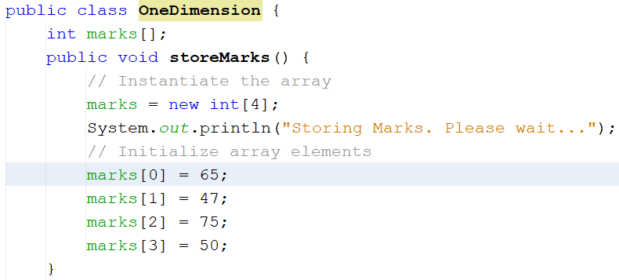
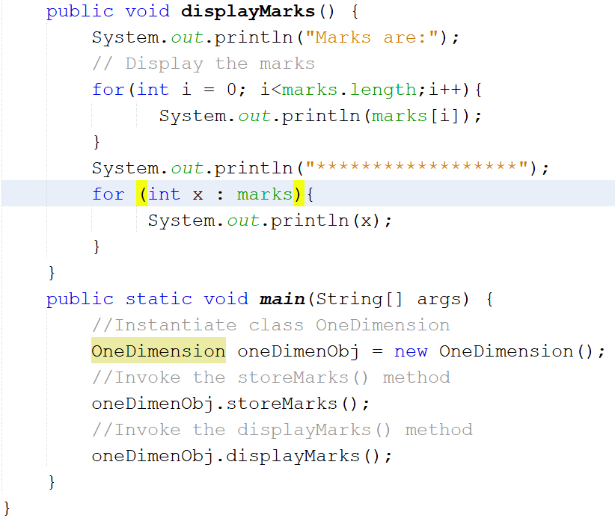
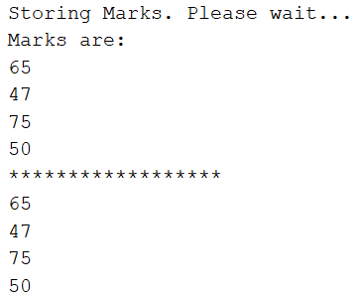
Demo 1D-Array

Slide 15
Multiple Dimensional Arrays
10
2002
9
2001
500
92
500
8
91
200
200
7
100
4
6
8000
5
3
1000
8000
2
replacement
1000
m
1
100
int m[][]= { {1,2,3,4}, {91,92}, {2001,2002}};
int[] replacement = {5,6,7,8,9,10};
m[1]= replacement;
m[i][j]
int[][] m; // declare a matrix
int r=10, c=5; // number of rows, columns
m= new int[r][c]; // memory allocate

Slide 16
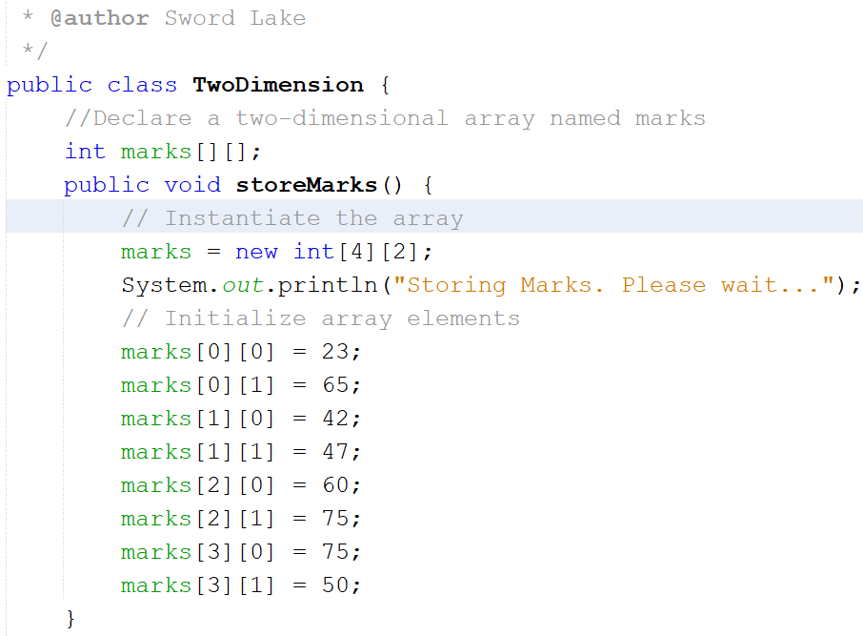
Demo 2D-Array

Slide 17
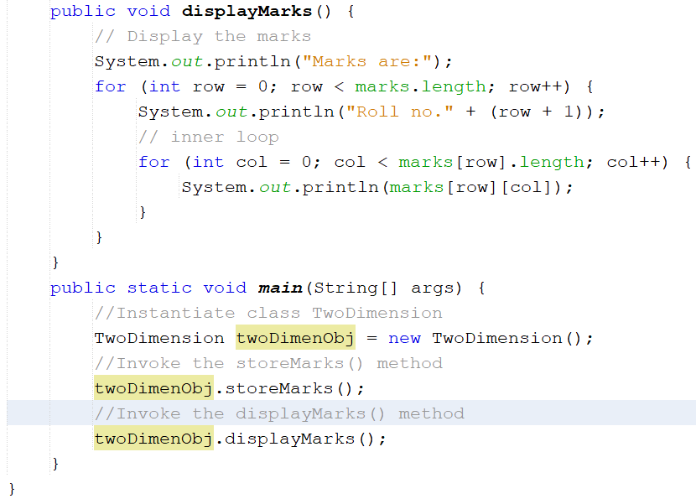
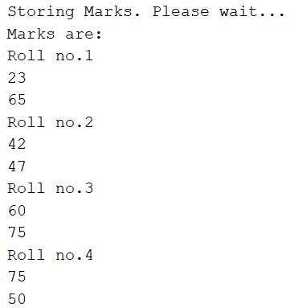

Slide 18
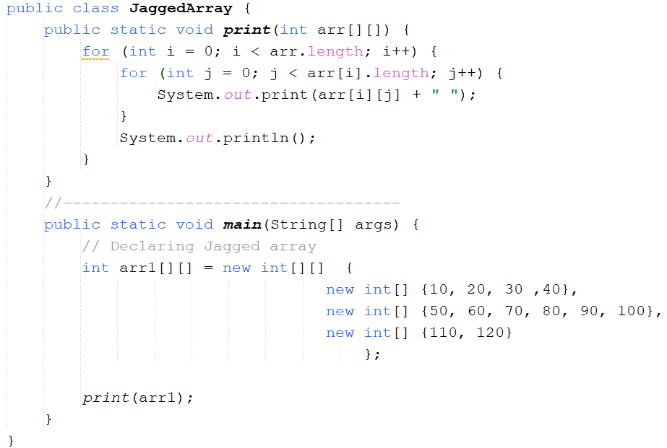
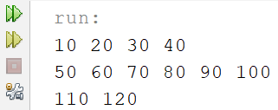
Jagged Array 01

Slide 19
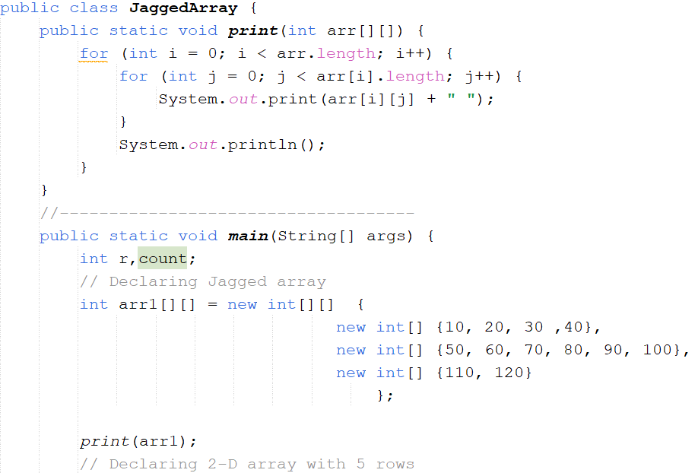
Jagged Array 02

Slide 20
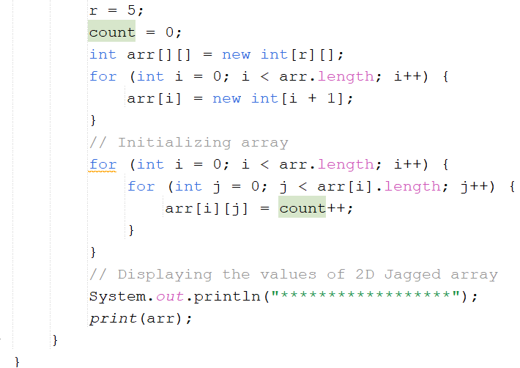
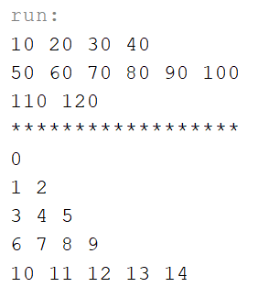
Jagged Array 02

Slide 21
Evaluating Expressions and Operator Precedence
The compiler generally evaluates such expressions from the innermost to outermost parentheses, left to right.
int x = 1; int y = 2; int z = 3; int answer = ((8 * (y + z)) + y) * x; would be evaluated piece by piece as follows: ((8 * (y + z) ) + y) * x ((8 * 5) + y) * x (40 + y) * x 42 * x 42

Slide 22
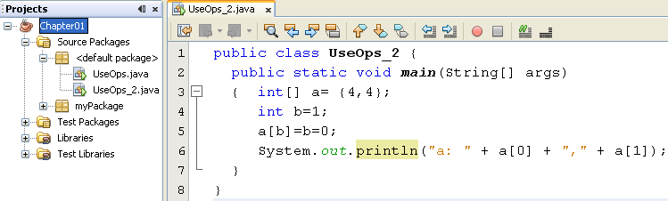

Operator Precedence- Evaluation Order
Order:
[ ] ➔ a[b] ➔ a[1]
= ( from the right) ➔ b=0 ➔ return 0
➔ a[1] = 0

Slide 23
Basic Constructs
They are taken from C-language
Selection
if, if … else
switch (char/int exp)… case … default…
Loops
for
do… while
while

Slide 24
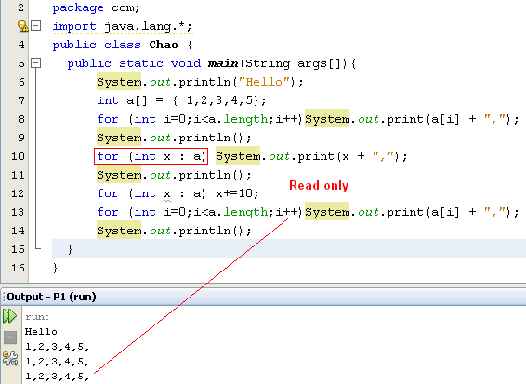
Basic Logic Constructs
They are the same with those in C-statements
An enhanced for loop
a
1
2
3
4
5
x
1
Notes:
int num = 5;
String str = String.format("%03d", num);
// 005
System.out.printf("Original number %d, leading with zero : %s", num, str);
// Original number 5, leading with zero : 005

Slide 25
The String type
A String represents a sequence of zero or more Unicode characters.
String name = "Steve";
String s = “”;
String s = null;
String concatenation.
String x = "foo“ + "bar“ + "!";
Java is a case-sensitive language.

Slide 26
Practice
Ex1. Write a program input a sentence of words separated by a space and count number of words that contain string s ( s inputted from keyboard) with no case sensitive
For example:
Input:
string : what You see is what YOU get?
s : yo
Output:
Count = 2

Slide 27
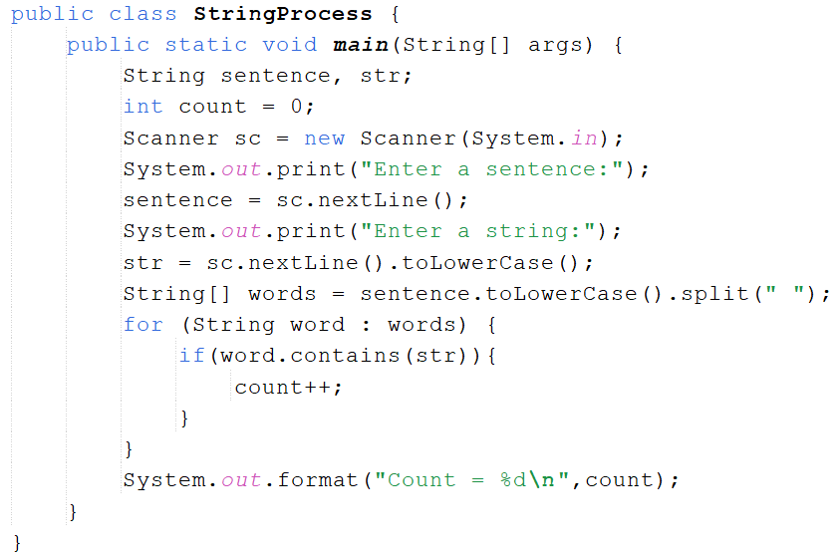
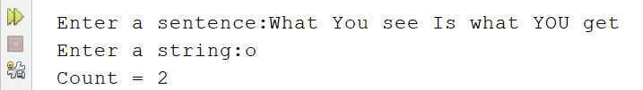

Solve Ex1

Slide 28
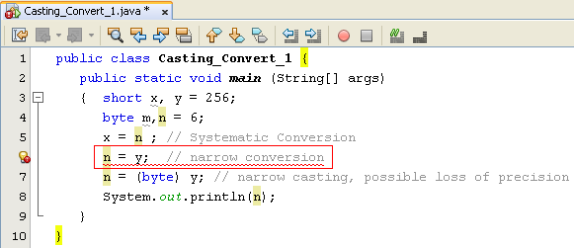
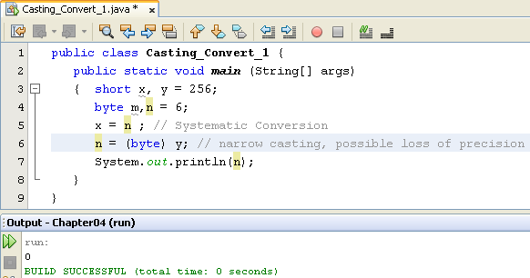
Type Conversions and Explicit Casting
* Widening Conversion: OK
Narrowing conversion: Not allowed. We must use explicit casting.
A boolean can not be converted to any other type.
A non-boolean can be converted to another non-boolean type.
0000 0001
0000 0000
0000 0000
y
n

Slide 29
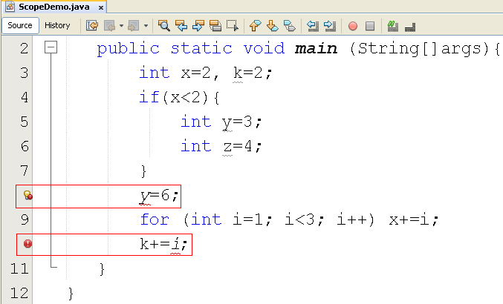
Scope of a Variable
Scope of the variable y
Scope of the variable i

Slide 30
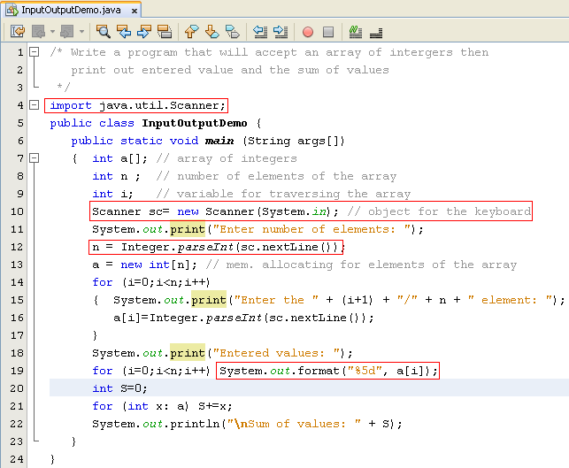
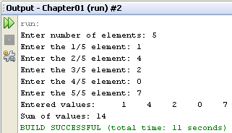
Input/Output Data
Class java.lang.System
Class java.util.Scanner
Refer to Java documentation:
java.lang.String class,
- the format method,
- format string
for more details
n= sc.nextInt();

Slide 31
Elements of Java Style
Proper Use of Indentation
Statements within a block of code should be indented relative to the starting/ending line of the enclosing block.
Use Comments Wisely
Placement of Braces
Opening brace at the end of the line of code that starts a given block. Each closing brace goes on its own line, aligned with the first character of the line con.
Descriptive Variable Names
Notes:
Comments wisely: If there can be any doubt as to what a passage of code does, precede it with a comment.
• Indent each comment to the same level as the block of code or statement to which it applies.
• Make sure that all comments add value—don’t state the obvious, as in the following fairly useless comment

Slide 32
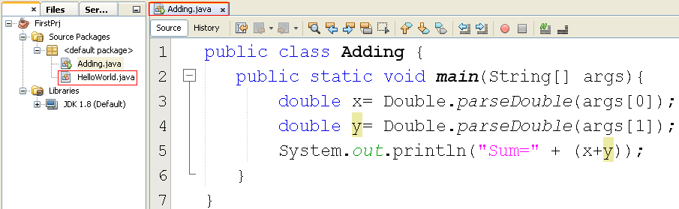
Pass Arguments to the method main

Slide 33
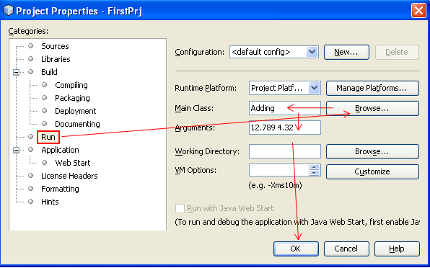
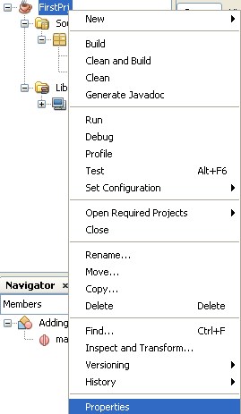
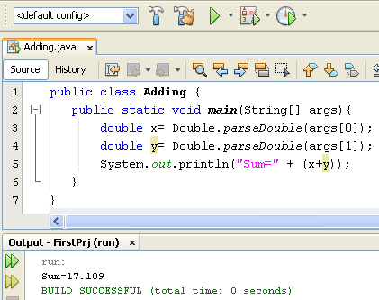
Pass Arguments to the method main
Notes:
Vào thư mục build\classes của project
1. tạo 1 tập tin run.txt
2. đổi tên run.bat hoặc run.cmd
3. nhập nọi dung như slide
java Adding 12.789 4.32
pause
4. double-click trên run.bat hoặc run.cmd
thay double-click bằng Enter cũng được

Slide 34
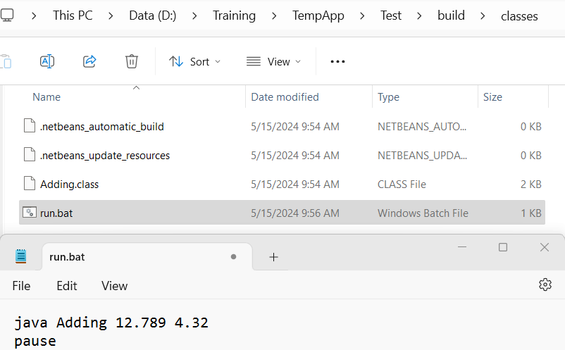
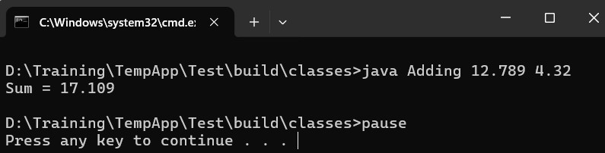
Run Java App by Command Line
#1 Mở thư mục build\classes của project (sử dụng File Explorer của Windows)
#2. Tạo 1 tập tin tên run.txt và nhập nội dung như sau:
java Adding 12.789 4.32
pause
#3. Đổi tên run.txt thành run.bat hoặc run.cmd
#4. Double-click trên run.bat (run.cmd) để chạy hoặc thay double-click bằng Enter

Slide 35
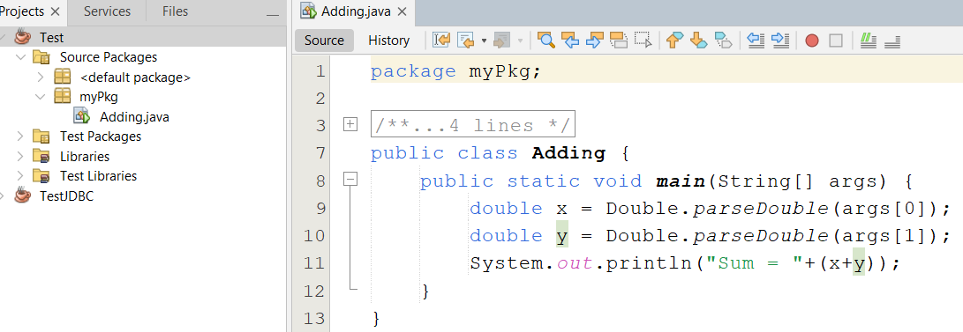
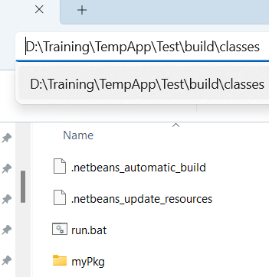
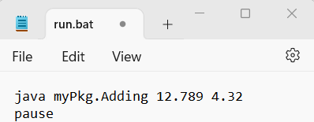
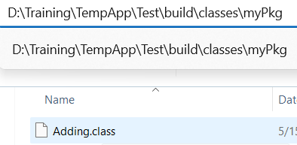
Run Java App by Command Line

Slide 36
What Is a Package?
A package is a namespace that organizes a set of related classes and interfaces.
The Java platform provides an enormous class library (a set of packages) suitable for use in your own applications called API.
For example, a String object contains state and behavior for character strings.

Slide 37
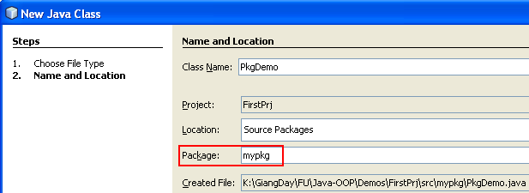
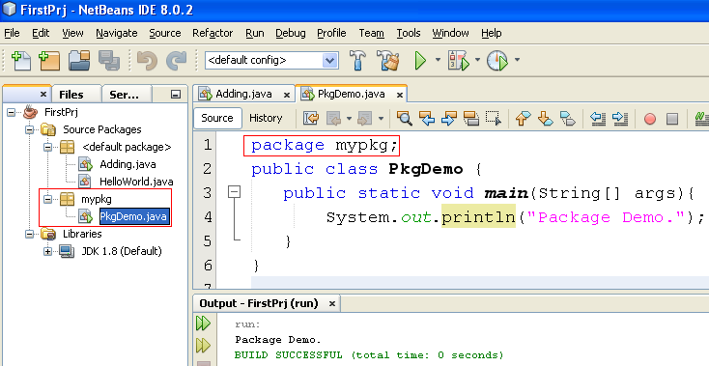
User-Defined Package
Add a Java class
If package is used, it must be the first line in Java code

Slide 38
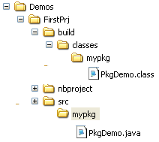
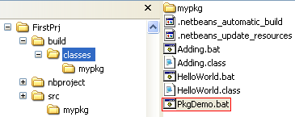
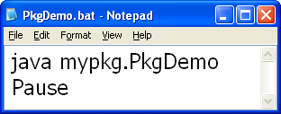
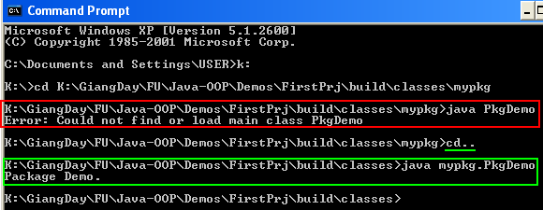
User-Defined Package

Slide 39
Ex1. Write a program input a string of words separated by a space and converts words starting with the letter 'a' or 'A' to uppercase.
For example:
Input:
string : how are you, how are you?
Output:
how ARE you, how ARE you?

Slide 40
Ex1. Write a program input a string of words separated by a space and converts words starting with the letter 'a' or 'A' to uppercase.
For example:
Input:
string : how are you, how are you?
Output:
how ARE you, how ARE you?
Ex2. Write a program input a string of words separated by a space and print string with title case.
For example:
Input:
string : hoW Are YOU?
Output:
How Are You?
Ex3. Write a program input a sentence of words separated by a space and replaces words are ended with vowels by string s ( s inputted from keyboard) no case sensitive.
For example:
Input:
sentence : I am learing java
String s : oop
Output:
oop am learing oop

Slide 41
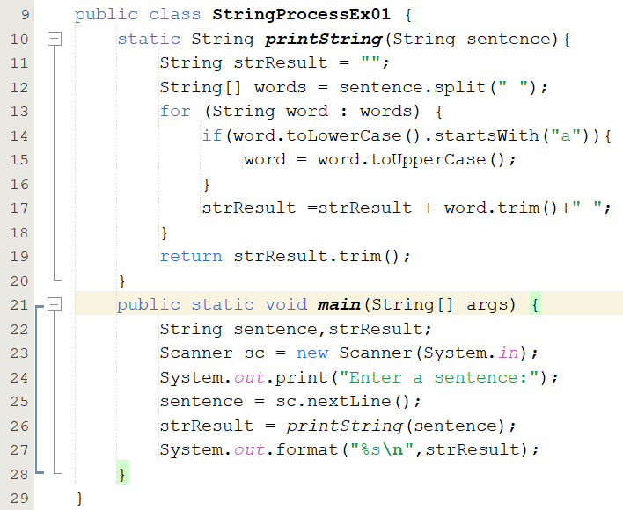

Solve Ex01

Slide 42
Summary
The core concepts behind object-oriented programming: objects, interfaces, classes, and inheritance.
The traditional features of the language, including variables, arrays, data types, operators, and control flow.

